Slide 1

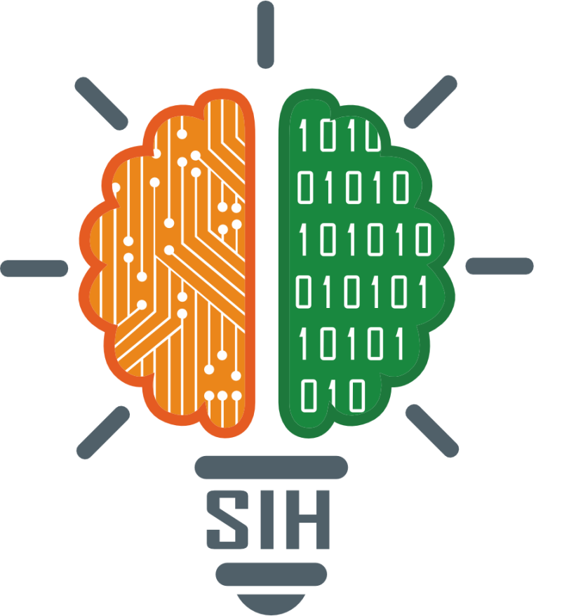
SMART INDIA HACKATHON 2024
TITLE PAGE
Problem Statement ID – 1672
Problem Statement Title- Develop a ML Model based solution to refine CAPTCHA.
Theme- Smart Automation
PS Category- Software
Team ID- 8
Team Name: globalhost:1672

Slide 2
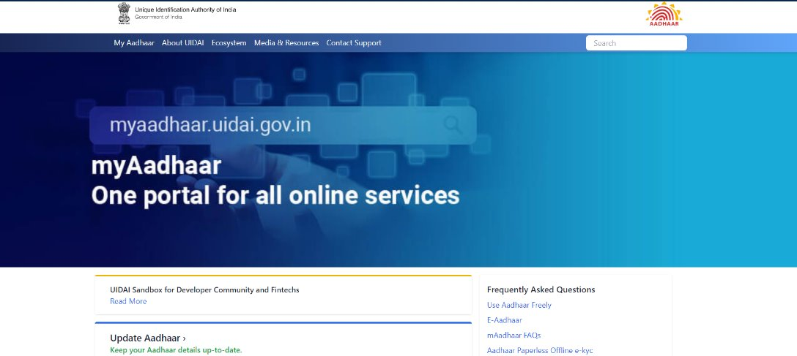
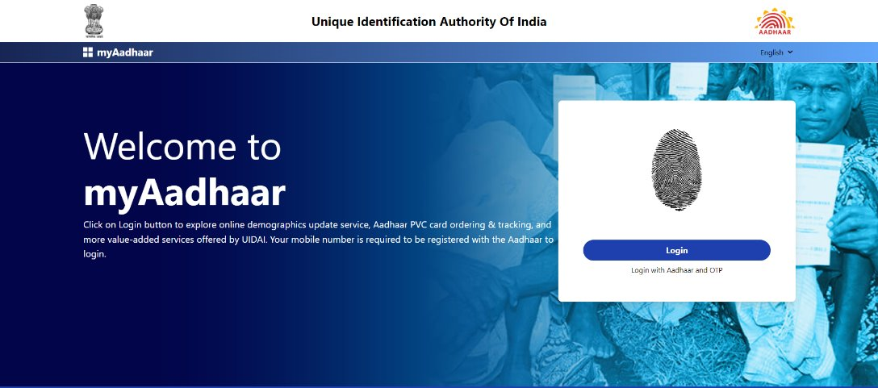
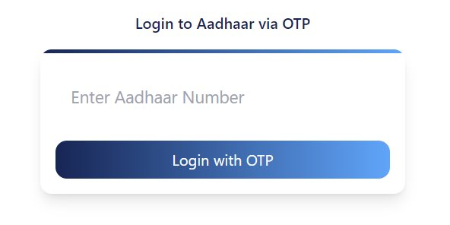
ML Model based solution to refine CAPTCHA.
Globalhost:
1672
Proposed Solution
Passive Detection: Collects and analyzes environmental data to distinguish between bots and humans without disrupting user experience.
ML Integration: Utilizes a backend machine learning model for accurate bot detection, with minimal interaction only if necessary, ensuring privacy and scalability.
Collected Parameters for Bot Detection:
Page Views: Tracks the number of pages visited to detect unusual navigation patterns.
Session Duration: Monitors how long a session lasts to identify abnormal session times.
Time on Page: Measures time spent on individual pages to spot irregular behavior.
Previous Visits: Tracks repeated visits to detect suspicious frequency.
IP Address: Collects IPs to analyze and block suspicious traffic.

Slide 3
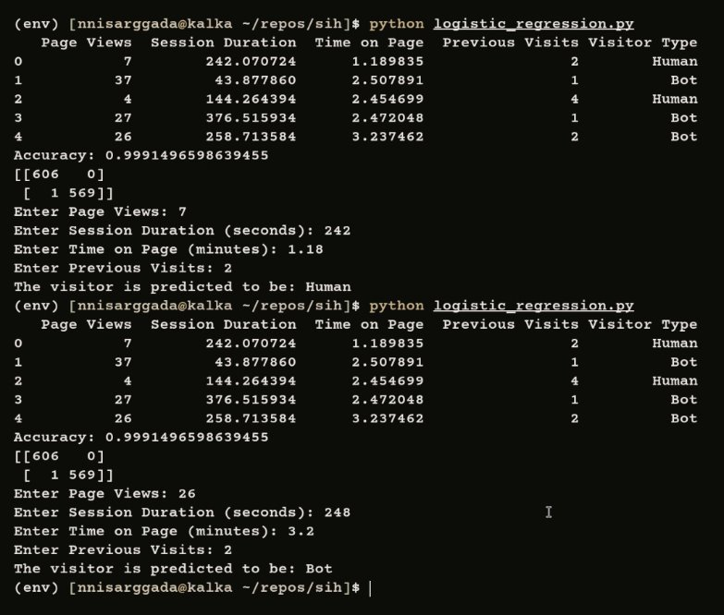
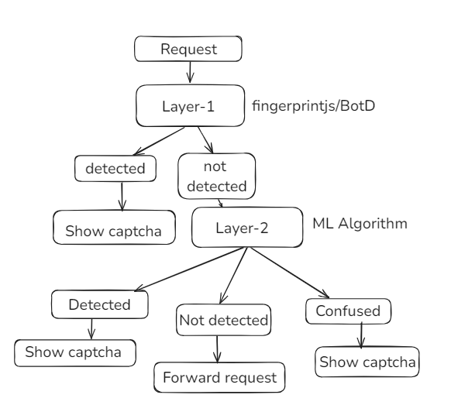
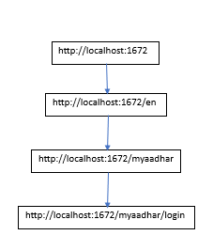
TECHNICAL APPROACH
Globalhost:
1672
Tech Stack used:
Frontend- Astro.js
Middleware- GO
Backend- Python (ML)
Layer 1 uses FingerprintJS/BotD to passively collect browser and device data, generating unique fingerprints for each session. It detects bot-like behaviors early, ensuring seamless bot identification without disrupting the user experience.
Layer 2 utilizes a Logistic Regression ML model to analyze the collected user data and environmental parameters. It classifies users as bots or humans based on patterns, with minimal interaction, ensuring accurate and real-time bot detection.

Slide 4
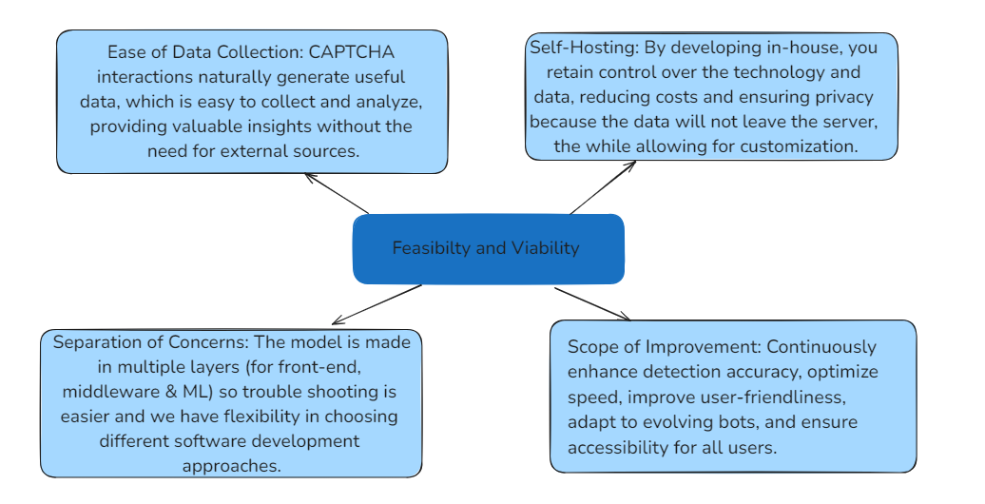
FEASIBILITY AND VIABILITY
Globalhost:
1672

Slide 5
IMPACT AND BENEFITS
Globalhost:
1672
Reduced Server Load: Bots consume resources and increase server costs. By preventing bot traffic, companies can reduce infrastructure costs.
Automation of Security: Instead of relying on manual monitoring, an automated system identifies and mitigates bot attacks in real time, reducing the need for constant human intervention.
Reduced Downtime: By blocking Distributed Denial of Service (DDoS) attacks, automated detectors keep websites running smoothly without interruption.
User experience: Reduce or remove high-friction user authentication mechanisms, including CAPTCHA and multifactor authentication, thereby improving the customer experience.

Slide 6
RESEARCH AND REFERENCES
Globalhost:
1672
https://github.com/fingerprintjs/BotD
https://github.com/nnisarggada/stabl
https://www.kaggle.com/datasets/anthonytherrien/website-traffic
https://blog.cloudflare.com/residential-proxy-bot-detection-using-machine-learning
https://altcha.org/
https://uidai.gov.in

